Slide 1

Lending Club Case Study
Group Members :
Rohan Raut
Akshay Manthekar

Slide 2
Problem Objective
To identify borrowers who might default on loans based on the past data.
To identify the parameters which form a trend among loan defaulters.
To help lending organizations carry out risk assessments on the loans offered.
Avoid business loss to the lending organizations.

Slide 3
Problem solving methodology
Understanding the Business Requirement
Objective and Criteria
Input Data
Loan.csv
Data Preparation
Identify the missing data
Remove unwanted data
Graphs
Plot the findings on a graph for visual representation
Logic Implementation
Identify the driving factors
Data Usage
Select relevant data
Delete/Impute the missing values
Conclusion
Conclude the findings
Presentation
Present the finding/conclusions through a Power-Point presentation

Slide 4
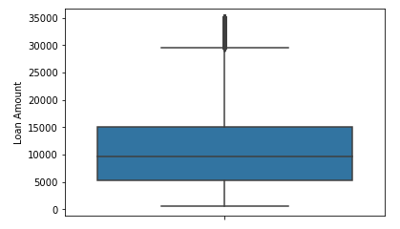
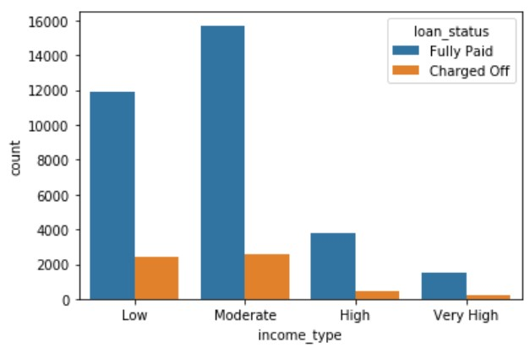
Loan Amount Analysis
The loan amount varies between the range 500 to 35000.
The average loan range lies between 5000 to 15000.
Annual Income Analysis
98.5% of the customers have income less than 2 Lacs
Around 17%(which is highest) of the customers having “Low” income (< 50000) tend to default on their loan than other income type customers

Slide 5
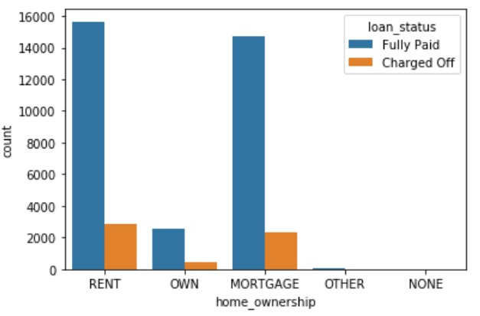
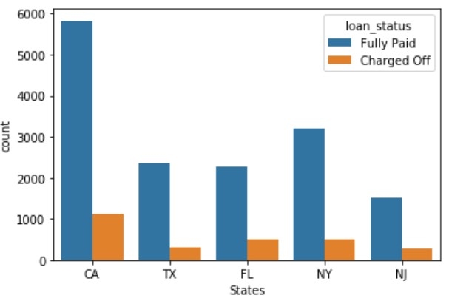
Home Ownership Analysis:
State Analysis:
Most of the customers don’t have their own house (~ 35000)
Charge off % trends are nearly equal for type of home ownership of customers but customers who live in rented house tend to default on their loan as compared to any other customers
Most of the customers are from California (~ 7000)
Also, these states have highest % of defaulters (~ 16.2%) which is far greater than any other state customers

Slide 6
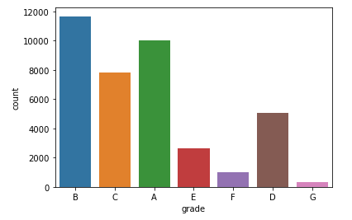
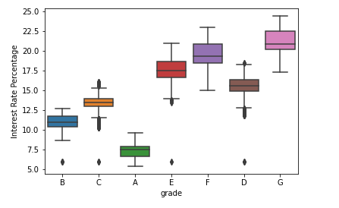
Grade Analysis
Most of the loans are graded as B, followed by A and then by C.
Most of the loans approved are higher graded loans.
The lower the grade the higher the interest rates.

Slide 7
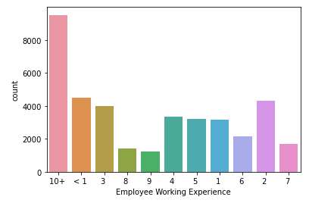
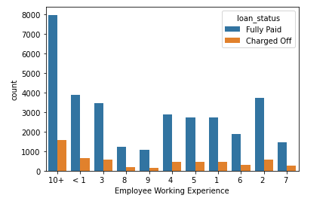
Employee Working Years
Majority of the employees applying for a loan have an experience of more than 10 years.
People with more than 10 years of experience also default more

Slide 8
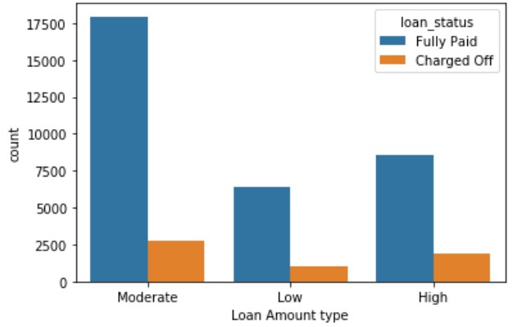
Loan Amount Analysis
95% of the loan amounts are less than 25000, we will bin the loan amounts as shown in the figure
0-5000 – Low, 5000-15000 – Moderate and >15000 – High
Almost 21000 customers opt for moderate loan amount
But the customers who opt for higher loan amount tend to default on their loan most frequently as compared to other loan amount types
Charge off rate in “High” loan amount is around 18%

Slide 9
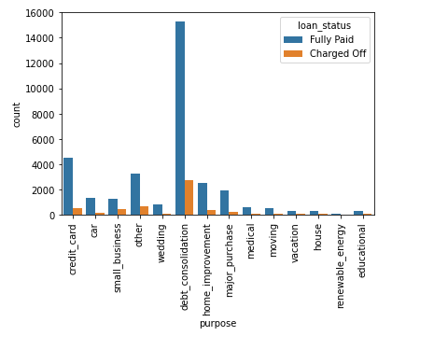
Purpose Analysis
Most of the loans are availed for debt_consolidation.
Even though most of the loans for this purpose is are completed, the count of defaulters for tis type of loan is also high.

Slide 10
Conclusions
Higher grade loans are generally safer while low grade loans display a tendency to default.
When the loan is requested for Debt_consolidation purposes, the employee background needs to be checked.
People with more than 10 years of experience also default more as compared to others.
Loans with high interest rates are generally riskier and have a less chance of being repaid.
Customers having low income tend to default more on their loan and also it is evident that customers living in rented house default more
According to the past history, California customers are large in numbers and also they tend to default significantly greater than other state customers
Lending club should be careful about customers asking for high amount loans as they tend to default more frequently

